Slide 1
Chapter 1
What Is Social Psychology?

Slide 2
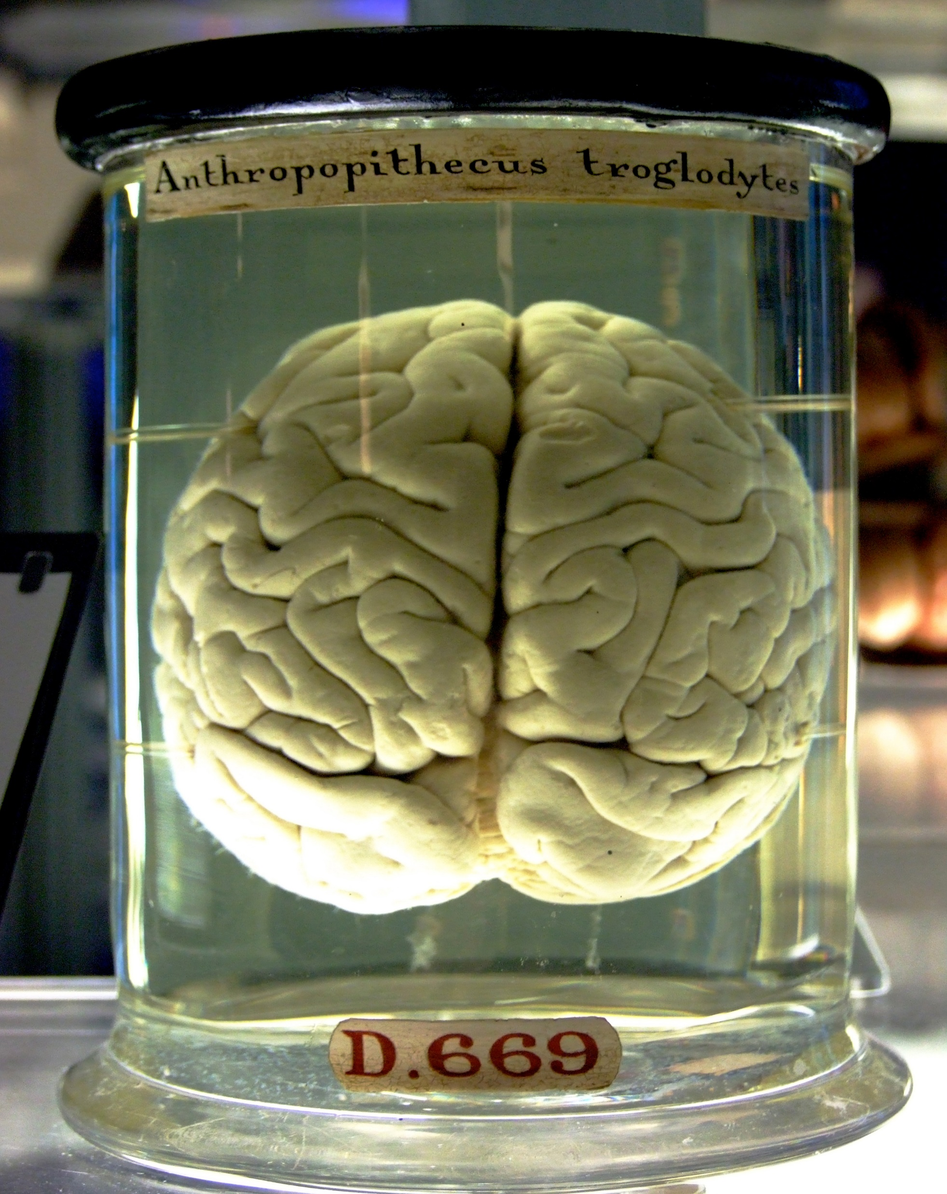
Overview
Humans vs. other animals:
  Larger brains relative to body size
  Advantages?
  Social advantage?
    We have such large brains in order to socialize (Oesch & Dunbar, 2018; von Hippel, 2018).

Slide 3
Humans are Social Animals
“Evolution has made a bet that the best thing for our brains to do in any spare moment is to get ready for what comes next in social terms” (E. E. Smith, 2013).
We focus on social situations because we’re social beings!

Slide 4
What is Social Psychology?
The scientific study of how individuals think, feel, and behave in a social context
  Scientific study
    Uses empirical methods!
    Systematic observation!
    Experiments!
  How individuals think, feel, and behave
    Focus is on the individual!

Slide 5
What is Social Psychology?
How is it different from other disciplines?
  A social context!
    How does the individual interact w/ other individuals?
  And its different from sociology because….?
    Social Psych focuses on the individual
    Sociology focuses on behavior of groups

Slide 6
Scientific Study
Social psychology applies the scientific method to the study of the human condition.
The scientific method applies:
  Systematic observation
  Description
  Measurement

Slide 7
Scientific Method (1)
Observe/
Question
Hypothesis
Experiment/
Test Hypothesis
Analyze Results
Form Conclusions

Slide 8
Topics in Social Psych
Social psychology concerns an amazingly diverse set of topics.
  People’s private, even nonconscious beliefs and attitudes
    Attraction, prejudices, etc.
  Emotions
    Are they universal? How do they affect behavior?
  Heroic, cowardly, or merely mundane public behaviors
    Bystander effect, helping behaviors, etc.

Slide 9
Social Context
Unique emphasis on the social nature of individuals:
  The “socialness” of social psychology varies
  Relevant when thoughts, feelings, or behaviors either (1) concern other people or (2) are influenced by other people
Do other people have to be physically present?
  Even the implied or imagined presence of others can have important effects on individuals.
  “Imagined others”

Slide 10
Some Statements
People think that they’re more unique than they really are.
People will like an activity more if you offer them a large reward for doing it.
Playing contact sports or violent video games releases aggression and makes people less likely to vent their anger in violent ways.

Slide 11
Social Psychology and Common Sense
The “knew-it-all-along” phenomenon
Common sense may seem to explain many social psychological findings after the fact.
  But common sense is sometimes wildly inaccurate, and often misleading in its simplicity.
Unlike common sense, social psychology uses the scientific method to put its theories to the test.

Slide 12
A Brief History of Social Psychology

Slide 13
The Birth and Infancy of Social Psychology: 1880s–1920s
Who was the founder of social psychology?
  English Psychologist William McDougall (1908), and two Americans Edward Ross (1908), and Floyd Allport (1924)
    These books helped to establish social psychology as the discipline it is today.

Slide 14
A Call to Action: 1930s–1950s
Who had the most dramatic impact on social psychology?
  Quite possibly Adolf Hitler!
  Caused people around the world to become desperate for answers to social psychological questions

Slide 15

A Call to Action: 1930s–1950s
Society for the Psychological Study of Social Issues formed in 1936 by Gordon Allport (brother of Floyd).
Still a thing! https://www.spssi.org/
Goal: Investigate psychological aspects of important social and policy issues.

Slide 16
A Call to Action: 1930s–1950s
World War II and Social Psych
  Prior to the war: Social psych was mainly philosophical
  During the war: Shift from philosophy to field research
  Post-War: Social Psych viewed as a legitimate science
Much of these advances were spurred by government research

Slide 17
A Call to Action: 1930s–1950s
Government work in World War II—protect soldiers from the enemy’s propaganda, persuade citizens to support the war effort, etc.
  How can we influence people’s belief’s/attitudes?
  World War II also led to examining the nature of prejudice, aggression, and conformity

Slide 18
A Call to Action: 1930s–1950s
Emphasis on testing and assessment:
  Measuring soldier’s attitudes
  Screening out individual’s thought to be susceptible to mental breakdowns under stress
  Predicting leadership ability

Slide 19
Some Milestones
Gordon Allport (1954)—published The Nature of Prejudice.
Solomon Asch (1951)—research on conformity
Leon Festinger (1954, 1957)—research on social comparison

Slide 20
Confidence and Crisis: 1960s–Mid-1970s
Stanley Milgram’s research—Destructive obedience demonstrations
Period of expansion and enthusiasm
Also a time of crisis and heated debate
  Strong disagreements to the laboratory experiment as the dominant research method

Slide 21
Social Psychology Today:
What Is Trending Now?

Slide 22
Pluralism: Mid-1970s–Present
Emergence of pluralism
  Acceptance of many methods of investigation in addition to the laboratory experiment
  Increased interest in processes relevant to cognitive psychology, leading to the creation of social cognition as a subfield
  Development of international and multicultural perspectives

Slide 23
Integration of Emotion, Motivation, and Cognition
“Cold” perspective—the role of cognition in explaining social psychological issues
“Hot” perspective—emotion and motivation as determinants of thoughts and actions
Interest today in integrating both
Growing interest in distinguishing between automatic and controllable processes, and understanding their relationship

Slide 24
Genetic and Evolutionary Perspectives
Behavioral genetics
  Examines the effects of genes on behavior
Evolutionary psychology
  Uses the principles of evolution to understand human social behavior

Slide 25
Cultural Perspectives
Defining “culture”
  A system of enduring meanings, beliefs, values, assumptions, institutions, and practices shared by a large group of people and transmitted from one generation to the next
Cross-cultural research
  Used to evaluate the universal generality or cultural specificity of theories and findings
  Multicultural research
  Examines racial and ethnic groups within cultures

Slide 26
The Social Brain and Body
Social neuroscience
  Study of the relationship between neural and social processes
Embodied cognition:
  Focuses on the close links between our minds and the positioning, experiences, and actions of our bodies
  People’s perceptions and judgments reflect and can influence their bodily experiences

